Slide 2
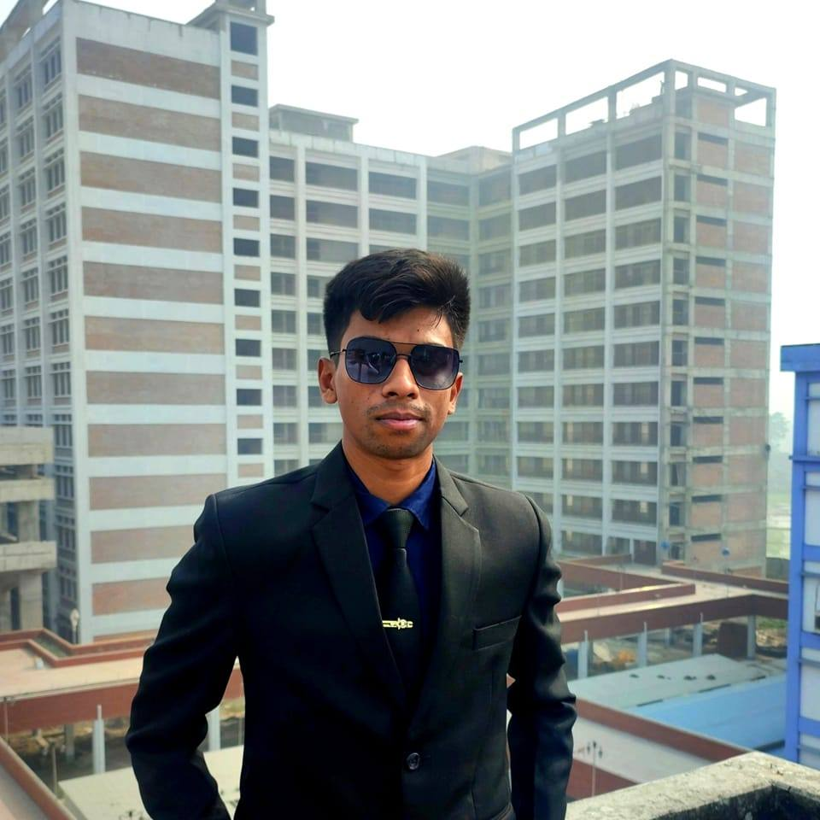
Monjur Morshed

